Slide 1
CSS
flexbox

Slide 2
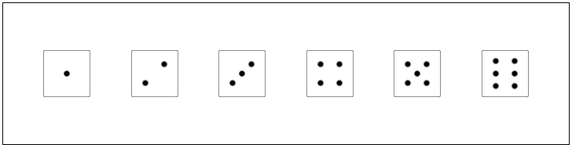
example
How do you position 6 dice side by side and centered in a div?
float
=> side by side, but how can you center?
=> clear needed to define height of div

Slide 3
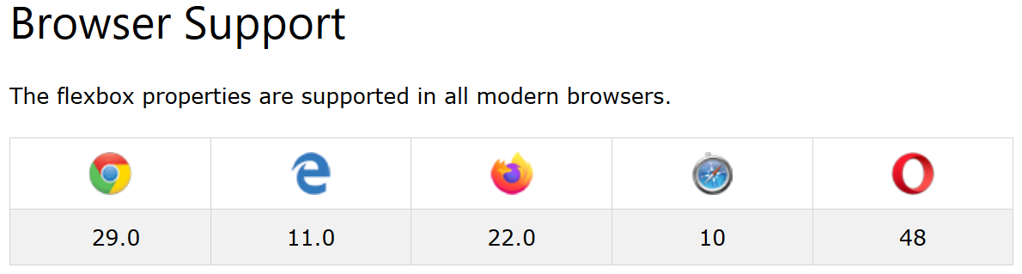
Browser support
http://caniuse.com/#search=flexbox

Slide 4
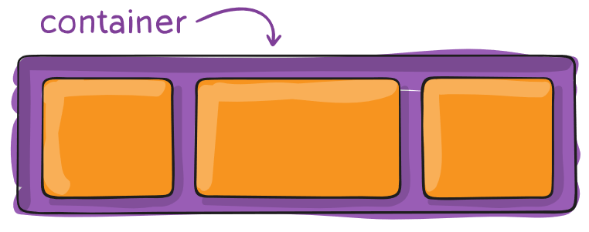
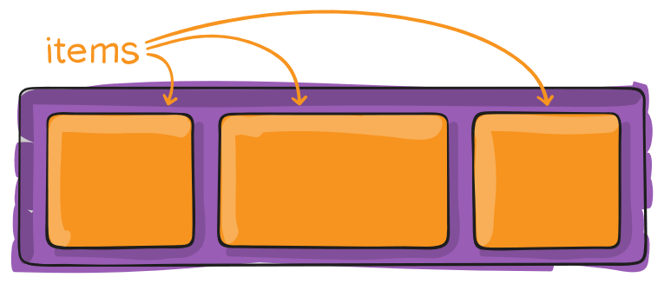
Flex container
Div needed with CSS property:
display: flex
All child elements become flex items

Slide 5
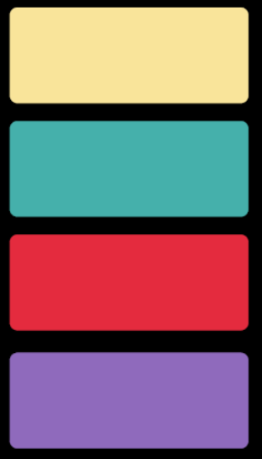
Flex is 1-dimensional!
Only 1 dimension, not both

Slide 6
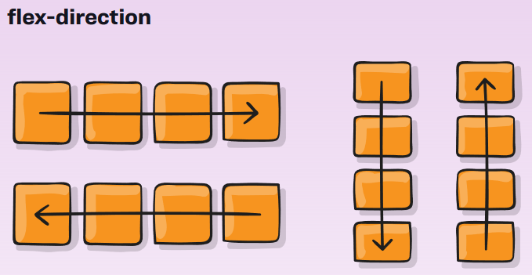
Flex-direction
CSS property for container
defines the main-axis
row (default): left -> right
row-reverse: right -> left
column: top -> bottom
column-reverse: bottom -> top
.container {
flex-direction: row | row-reverse | column | column-reverse;
}

Slide 7
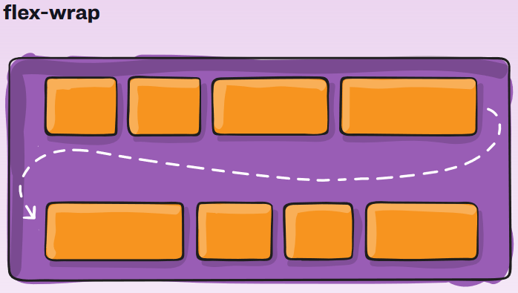
Flex-wrap
CSS property for container
defines what to do if line is not long enough
nowrap (default): on 1 lijn
wrap: on more lines top -> bottom
wrap-reverse: on more lines
bottom -> top
.container {
flex-wrap: nowrap | wrap | wrap-reverse;
}

Slide 8
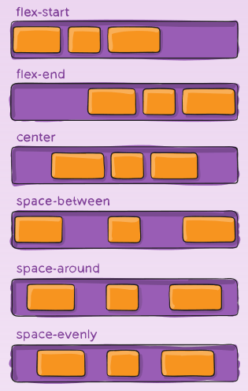
Justify-content
CSS property for container
Aligns items horizontally
default
.container {
justify-content: flex-start | flex-end | center | space-between | space-around | space-evenly
}

Slide 9
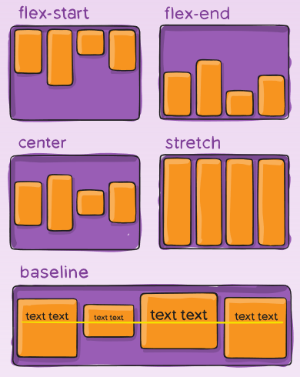
Align-items
CSS property for container
Aligns items vertically
default
.container {
align-items: stretch | flex-start | flex-end | center | baseline
}

Slide 10
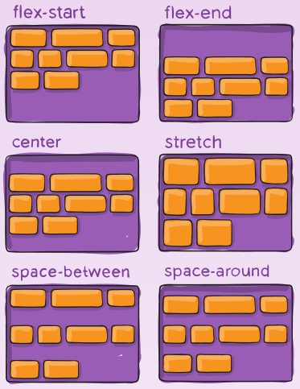
Align-content
CSS property for container
Aligns lines vertically
default
.container {
align-content: stretch | flex-start | flex-end | center | space-between | space-around;
}

Slide 11
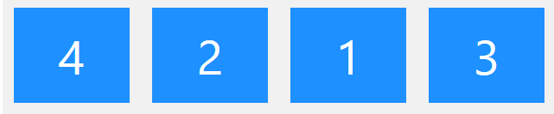
order
CSS property for items
defines order to display items (default order is defined by order in HTML code)
.item {
order: <integer>;
}

Slide 12
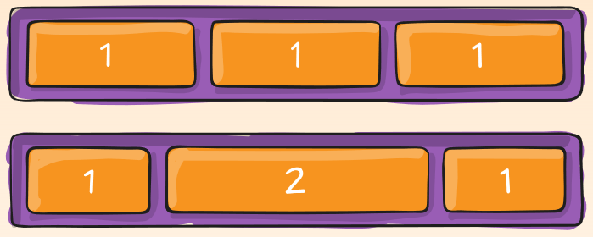
Flex-grow
CSS property for items
defines how much an item grows relative to the other items if there is enough room
.item {
flex-grow: <pos number>; /*default 0*/
}

Slide 13
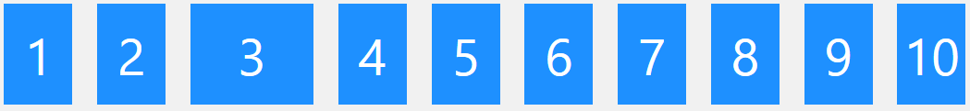
Flex-shrink
CSS property for items
defines how much an item shrinks relative to the other items when there is too little space
.item {
flex-shrink: <pos number>; /*default 1*/
}

Slide 14
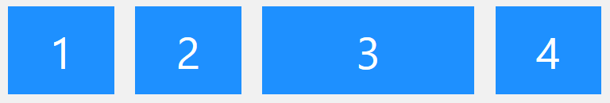
Flex-basis
CSS property for items
defines start width for item (grow)
defines minimum width for item (wrap)
<div class="flex-container"> <div>1</div> <div>2</div> <div style="flex-basis: 200px">3</div> <div>4</div> </div>

Slide 15
flex
shorthand notation
.item {
flex: none | [ <'flex-grow'> <'flex-shrink'>? || <'flex-basis'> ]
}

Slide 16
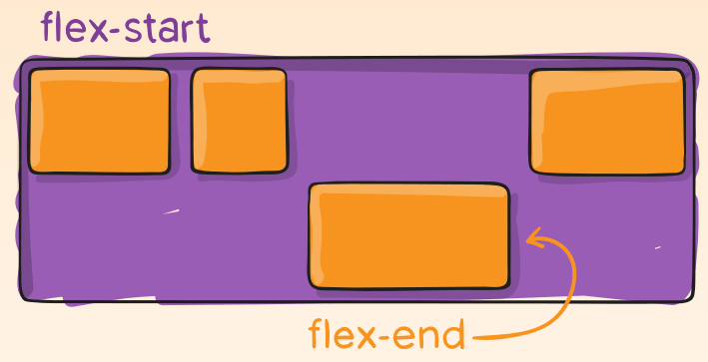
Align-self
CSS property for items
Overwrites alignment of container for specific flex item
.item {
align-self: auto | flex-start | flex-end | center | baseline | stretch;
}

